Slide 1
Activity 3: Generating Content: Maze Generation
Aqiff Mursyideen
WID170005 @ 17141207/1

Slide 2
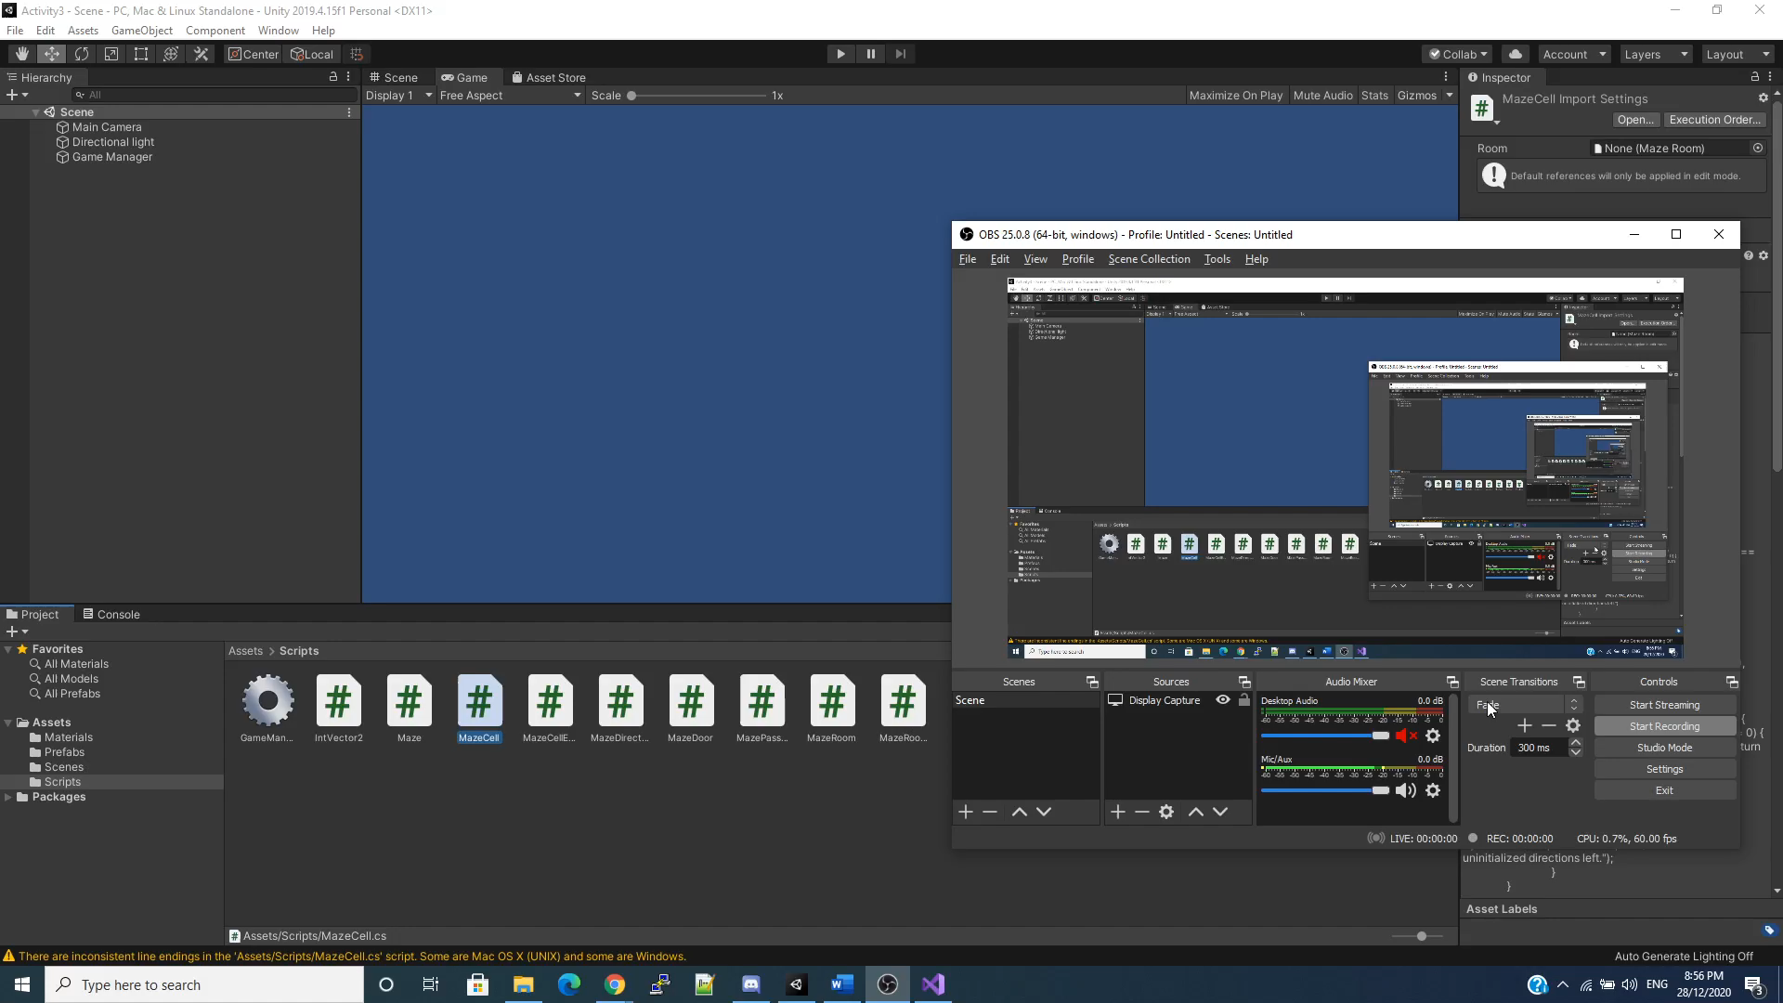
Demonstration (Default Program)

Slide 3
Explanation
In their Catlike Coding tutorial, the author mentions that they use Growing Tree algorithm
Growing Tree works similarly with recursive backtracker when implemented with some slight changes, it can work similarly with Prim’s algorithm
What Growing Tree does is:
Let C be a list of cells, initially empty. Add one cell to C, at random.
Choose a cell from C and carve a passage to any unvisited neighbor of that cell, adding that neighbor to C as well. If there are no unvisited neighbors, remove the cell from C.
Repeat #2 until C is empty.

Slide 4
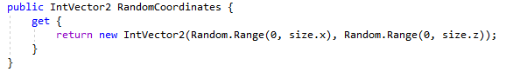
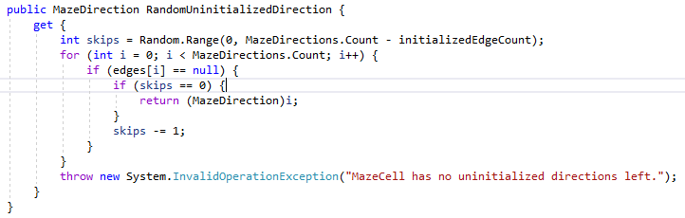
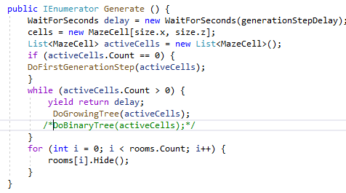
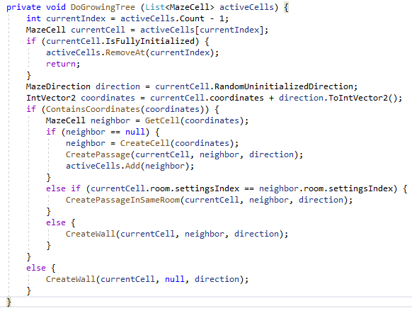
Algorithm
Generating random coordinates
Add each random coordinates into the list
Add random neighbour with their random direction and coordinates
Generate walls, floor and room

Slide 5
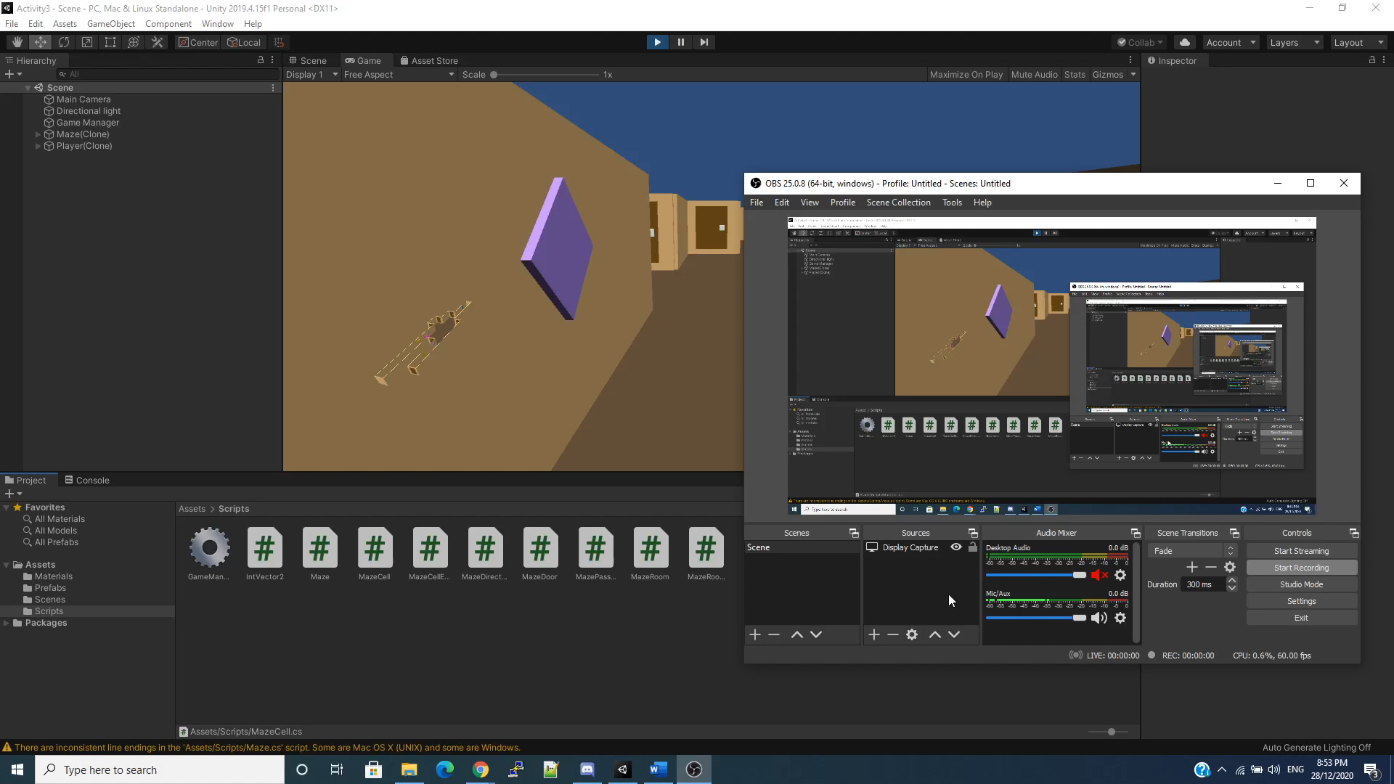
Demonstration (My Program)

Slide 6
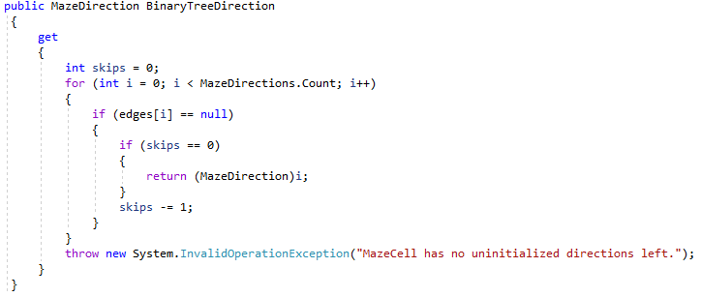
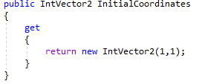
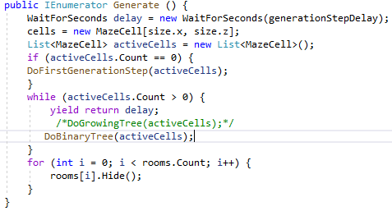
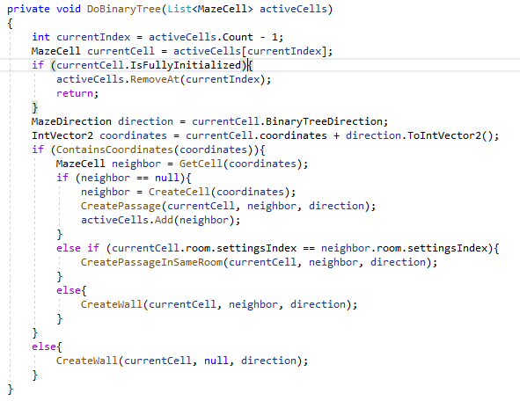
Algorithm
Start at starting point coordinate (1,1)
Check neighbour coordinate (skip = 0)
Generate walls, floor and room in one big cycle

Slide 7
Explanation
For my algorithm, I made a slight changes, which is a simple algorithm, Binary Tree
Binary tree is a simple algorithm by generating long corridors spanning two sides and a notable bias.

